Slide 1

Housing Price Prediction in New York City
Presented by : Latha Saradha
Semester: August 2020

Slide 2
CONTENTS
Introduction
Research Question
Data Preparation
Data cleaning & pre-processing
Data Analysis
Data Standardization
Machine Learning Models
Model Evaluation Metrics
Linear Regression
SVM Regression
K- Nearest Neighbor
Random Forest Regression
XGBoost Regression
Results
Future Work
References
Notes:
Major topics covered are …

Slide 3
INTRODUCTION
The United States house sales have grown by 34% since 2010 *
House price prediction has gained extensive attention
Buyers, sellers, and real estate agents could benefit from house price prediction
The accuracy of prediction has become an important criterion
*arXiv:1901.01774
Notes:
In the United States, house sales have grown by 34% in the last decade and reached a record high of 5.51 million units in 2019.
All three major categories of stakeholders (buyers, sellers, and real estate agents) in the real estate market could benefit from house price prediction.

Slide 4
Research Question
Find out the optimal Machine Learning Model for housing price prediction in New York City
The Model is applied on an original real-life dataset
Dataset includes house characteristics and geographical features

Slide 5
data preparation
Data collected from different sources are combined
A house’s price depends upon its features, and external factors
Additional datasets include:
School Rating
Crime count in the locality
Retail food stores proximity
NYPD complaints recorded for the year 2019
New York City substations proximity
New York City population
New York City health care facilities
School Safety report
Notes:
Redfin Data include house characteristics

Slide 6
data cleaning & pre-processing
Following data cleaning steps were performed
Remove duplicate records
Records with no details for “beds”, “baths” were removed
Missing values of “square feet” column was filled with mean, grouping the beds and baths
5 major categories - 'Condo/Co-op', 'Single Family Residential', 'Multi-Family (2-4 Unit)', 'Townhouse', and 'Multi-Family (5+ Unit)’
‘Year built’ feature from the housing dataset was converted to “Age”
Columns with insignificant information are removed
Records with Zip Code length not equal to 5 are removed
‘City’ feature is converted to numeric value with ASCII character sum
Additional datasets are combined with housing dataset
Notes:
Columns with insignificant info are removed –'SALE_TYPE','SOLD_DATE','DAYS_ON_MARKET','NEXT_OPEN_HOUSE_START_TIME
With the help of latitude, longitude, Zipcode, Manhattan distance etc.
hospital – 5 miles subwaystation – 1mile
Complaints – 1 mile
School – 3 mile

Slide 7
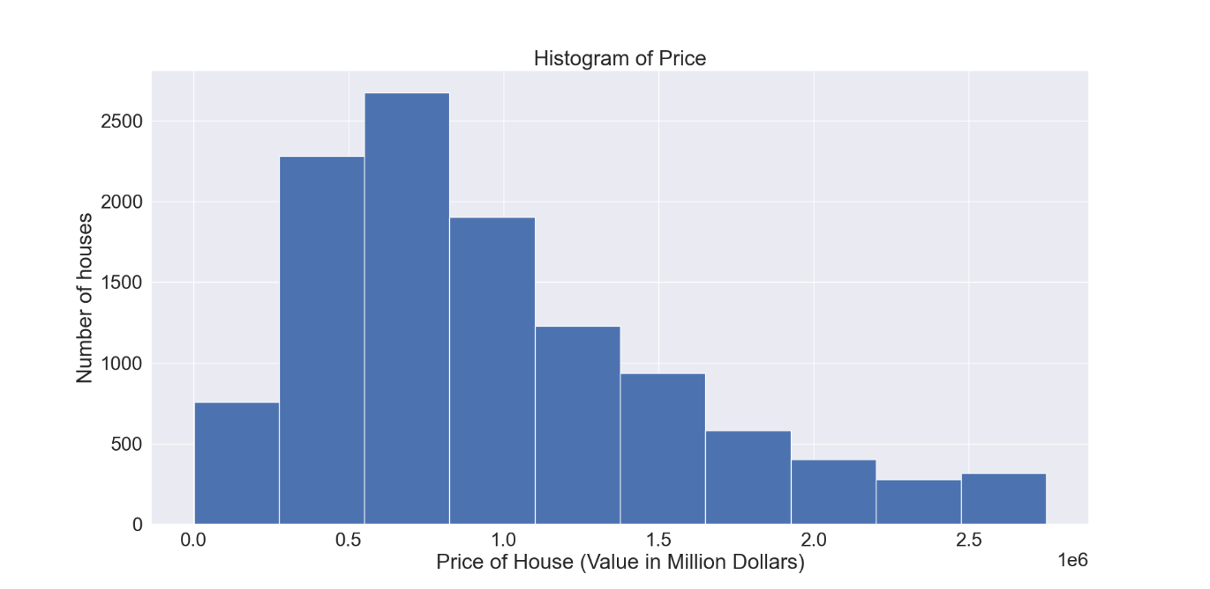
data Analysis
Combined Dataset contains 11364 records and 33 features, 27 of which are numeric
A large number of houses in the range between 250K$ to 1M$.
As the price of the house increases the count is decreasing gradually.

Slide 8
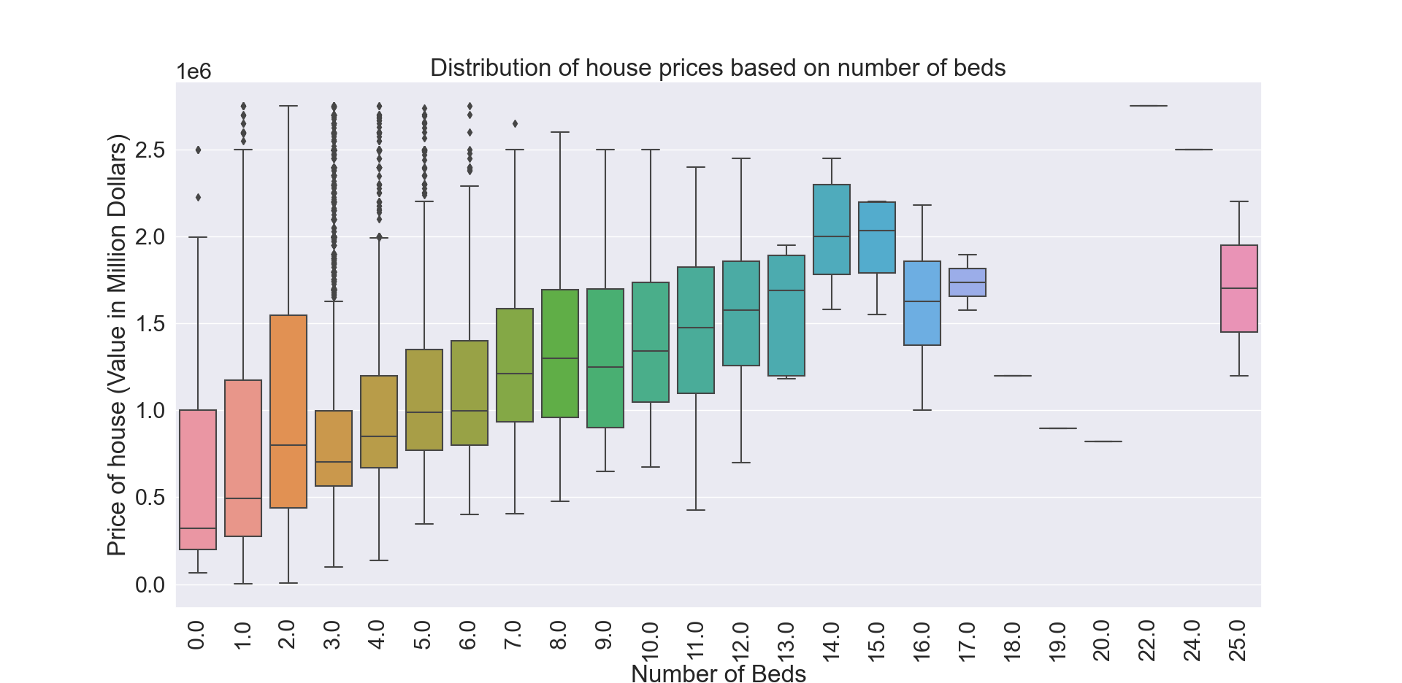
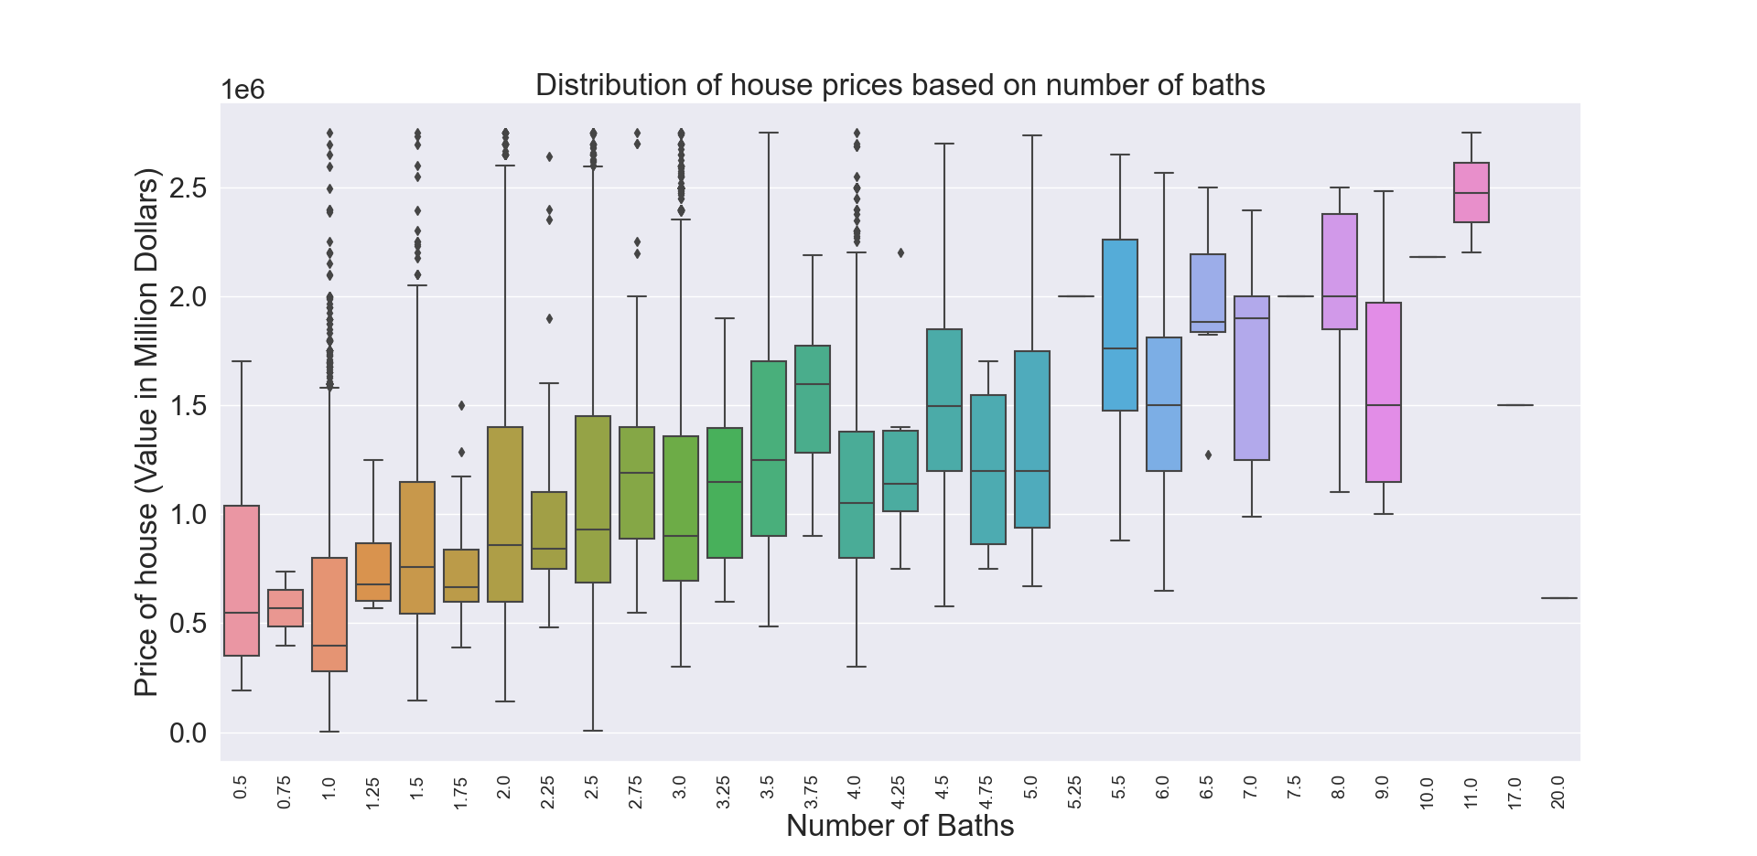
NoBa increases gradually from 0 to 6, the house prices also increase
Beyond 6, the NoBa have an unsymmetrical impact on the price of a house
As the NoB increases gradually from 0 to 15, the house prices also increase.
Beyond 15, the NoB has no impact on the price of a house
When the NoB is between 3 and 6, the house price appears to be at a higher value

Slide 9
data Analysis (continued)
Significant correlation to the ‘Price of house’ -> ‘Total Number of Complaints’, ‘Level A school count’, ‘Total Number of Subways’, ‘Number of Retail Stores’, ‘Total Number of Hospitals’.
‘Total Number of complaints’ are positively correlated with high value to ‘Total Number of Subways’, ‘Total Number of Schools’, and ‘Total Number of Hospitals’.
“Minimum distance to station” and “Minimum distance to retail store” are related to the location of the house.
“Total Crimes”, “Age of the house”, “Minimum distance to station”, and “Minimum distance to retail store” have a negative correlation to the price of the house.
“people per square mile” is positively correlated to the price of the house.
Notes:
Correlation was identified between the features

Slide 10
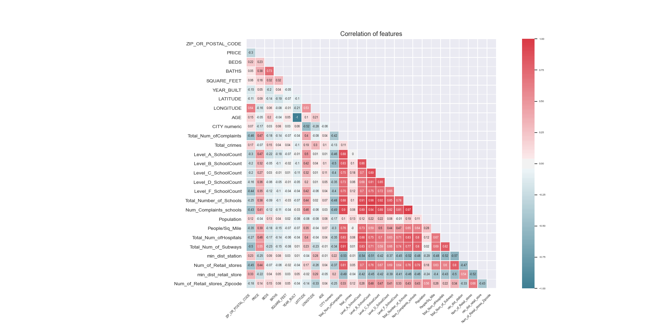
Notes:
The distance of station was calculated according to the location of house.

Slide 11

Data Standardisation
Data feature scaling is implemented
Applied to independent variables or features of data
Normalize the data within a particular range
$$x^{′}=\frac{x−\overline{x}}{σ}$$
$$where x is the original feature vector;$$
$$\overline{x}= average\left(x\right) is the mean of the feature vector$$
$$and σ is its Standard deviation.$$
Notes:
Every feature has varying degrees of magnitude, range, and units

Slide 12
machine learning models
Single Fold validation technique is used
It involves partitioning the original observation dataset into two
One being training set, used to train the model
One set to evaluate the accuracy of the Model
Combined house and additional dataset, it is split into two sections X and Y. X is the model’s input (house features) and Y is the model’s output (house price)
The X and Y dataset is split into two subsets, one for training the machine learning model and another for testing the model.
Notes:
Cross-validation is a technique that involves partitioning the original observation dataset into a training set, used to train the model, and an independent set used to evaluate the analysis.

Slide 13
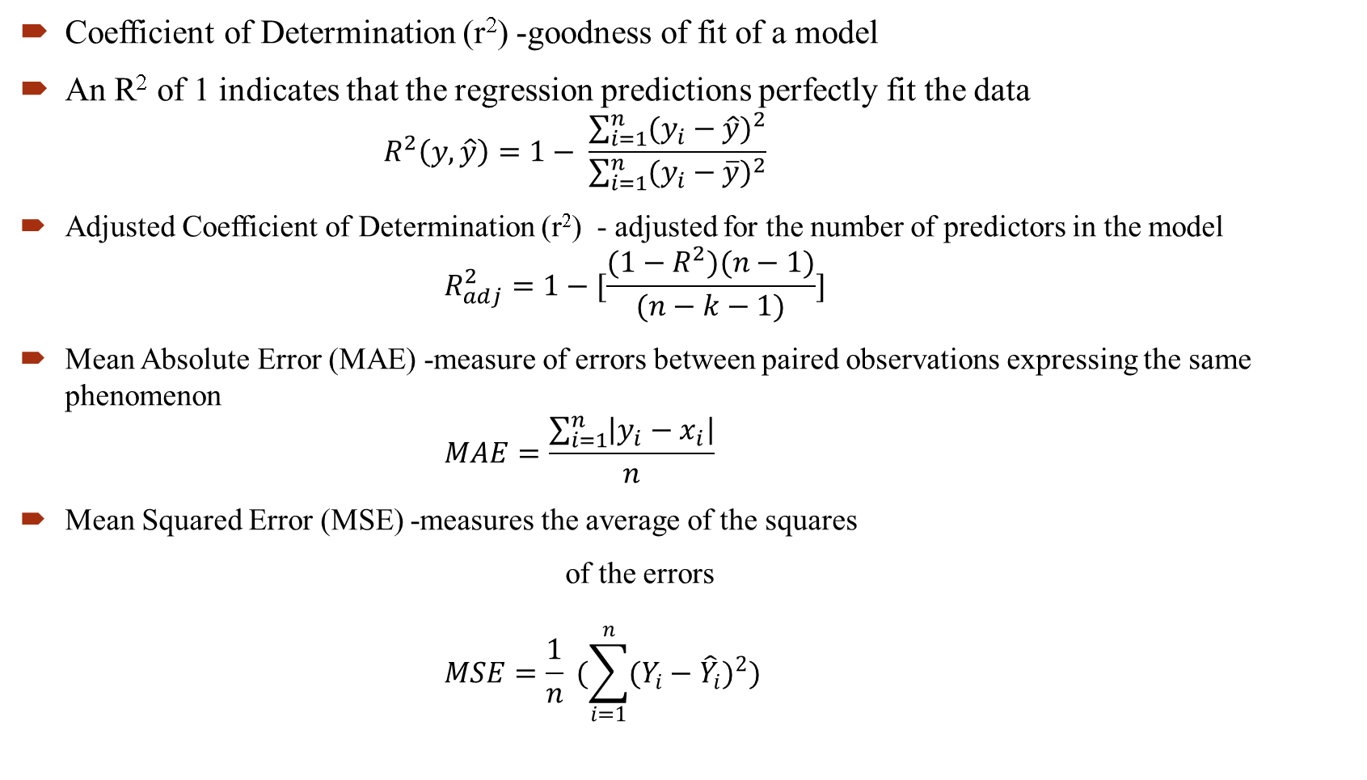
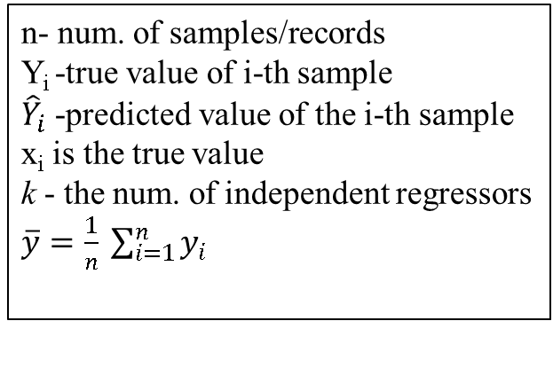
Model Evaluation Metrics
Coefficient of Determination (r²) -goodness of fit of a model
An R² of 1 indicates that the regression predictions perfectly fit the data
$$R^{2}\left(y,\hat{y}\right)=1− \frac{\sum_{i=1}^{n}{{(y_{i}−\hat{y})}^{2}}}{\sum_{i=1}^{n}{{(y_{i}−\overline{y})}^{2}}}$$
Adjusted Coefficient of Determination (r²) - adjusted for the number of predictors in the model
$$R_{adj}^{2}=1−[\frac{(1−R^{2})(n−1)}{(n−k−1)}]$$
Mean Absolute Error (MAE) -measure of errors between paired observations expressing the same phenomenon
$$MAE=\frac{\sum_{i=1}^{n}{\left|y_{i}−x_{i}\right|}}{n}$$
Mean Squared Error (MSE) -measures the average of the squares
of the errors
$$MSE=\frac{1}{n} (\sum_{i=1}^{n}{{(Y_{i}−{\hat{Y}}_{i})}^{2}})$$
n- num. of samples/records
Y_{i} -true value of i-th sample
${\hat{Y}}_{i}$ -predicted value of the i-th sample
x_{i} is the true value
k - the num. of independent regressors
$\overline{y}=\frac{1}{n} \sum_{i=1}^{n}{y_{i}}$
Notes:
k is the number of independent regressors, i.e. the number of variables in the model excluding the constant.

Slide 14
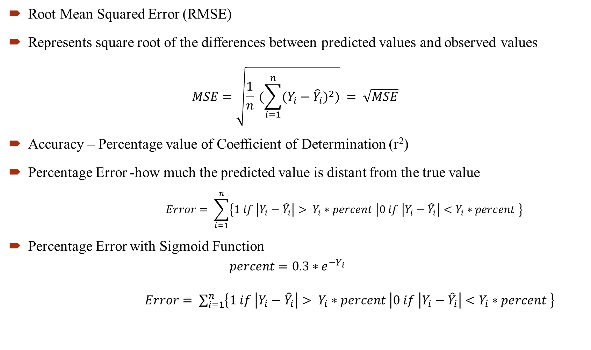

Model Evaluation Metrics (Continued)
Root Mean Squared Error (RMSE)
Represents square root of the differences between predicted values and observed values
$$MSE=\sqrt{\frac{1}{n} (\sum_{i=1}^{n}{{(Y_{i}−{\hat{Y}}_{i})}^{2}})} = \sqrt{MSE}$$
Accuracy – Percentage value of Coefficient of Determination (r²)
Percentage Error -how much the predicted value is distant from the true value
$$Error= \sum_{i=1}^{n}{\left\{1 if \left|Y_{i}−{\hat{Y}}_{i}\right|> Y_{i}∗percent | 0 if \left|Y_{i}−{\hat{Y}}_{i}\right|<Y_{i}∗percent \right\}}$$
Percentage Error with Sigmoid Function
$$percent=0.3∗e^{−Y_{i}}$$
$Error= \sum_{i=1}^{n}{\left\{1 if \left|Y_{i}−{\hat{Y}}_{i}\right|> Y_{i}∗percent | 0 if \left|Y_{i}−{\hat{Y}}_{i}\right|<Y_{i}∗percent \right\}}$
n- number of samples/records
Y_{i} -true value of i-th sample
${\hat{Y}}_{i}$ -predicted value of the i-th sample.
Notes:
Sigmoid function was used to find the percentage deviation allowed for each record separately.
to avoid a fixed percentage deviation for every record

Slide 15
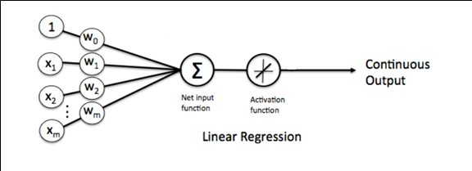

Linear Regression
A linear approach to modeling the relationship between a dependent variable
$$y=w_{0}+ w_{1}X_{1}+w_{2}X_{2}+….w_{n}X_{n}+ε$$
Where y is the dependent variable to be estimated, and X are the independent variables and $ε$ is the error term.$w_{i}$’s are the regression coefficients.
Types of linear Regression -> Ridge, Lasso, Positive Lasso, and Elastic Net

Slide 16
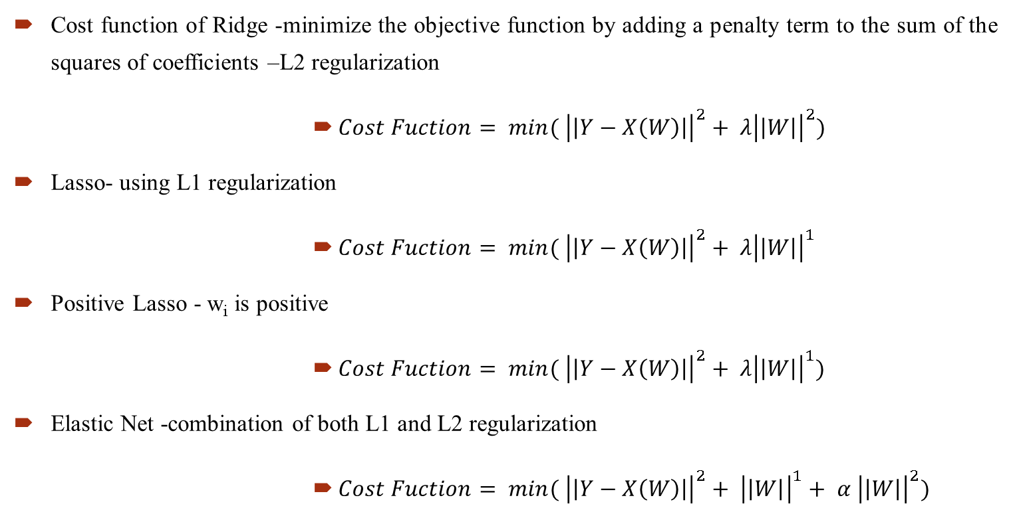
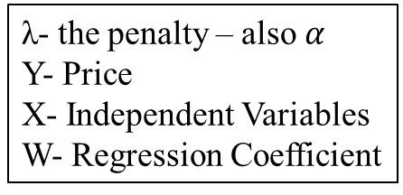
Linear Regression (Continued...)
Cost function of Ridge -minimize the objective function by adding a penalty term to the sum of the squares of coefficients –L2 regularization
$Cost Fuction= min⁡( {\left|\left|Y−X\left(W\right)\right|\right|}^{2}+ λ{\left|\left|W\right|\right|}^{2})$
Lasso- using L1 regularization
$Cost Fuction= min⁡( {\left|\left|Y−X\left(W\right)\right|\right|}^{2}+ λ{\left|\left|W\right|\right|}^{1}$
Positive Lasso - w_{i} is positive
$Cost Fuction= min⁡( {\left|\left|Y−X\left(W\right)\right|\right|}^{2}+ λ{\left|\left|W\right|\right|}^{1})$
Elastic Net -combination of both L1 and L2 regularization
$Cost Fuction= min⁡( {\left|\left|Y−X\left(W\right)\right|\right|}^{2}+ {\left|\left|W\right|\right|}^{1}+ α {\left|\left|W\right|\right|}^{2})$
λ- the penalty – also $α$
Y- Price
X- Independent Variables
W- Regression Coefficient
Notes:
Least Absolute Shrinkage and Selection Operator -In L1 regularization we try to minimize the objective function by adding a penalty term to the sum of the absolute values of coefficients.
Search Results
Regression coefficients are estimates of the unknown population parameters and describe the relationship between a predictor variable and the response.

Slide 17
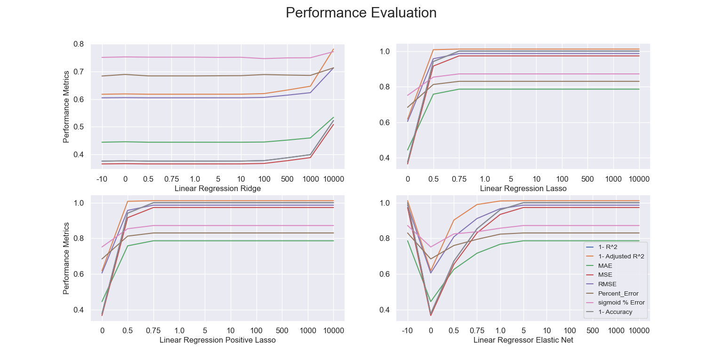
Linear Regression (Continued...)
Alpha –a parameter balances minimizing MSE and model coefficients
When alpha is increasing the errors are increasing
Regularization has less or no effect on the obtained results
Notes:
Alpha indicates the regularization strength..
Higher the values of alpha, bigger is the penalty and therefore the magnitude of coefficients is reduced.

Slide 18
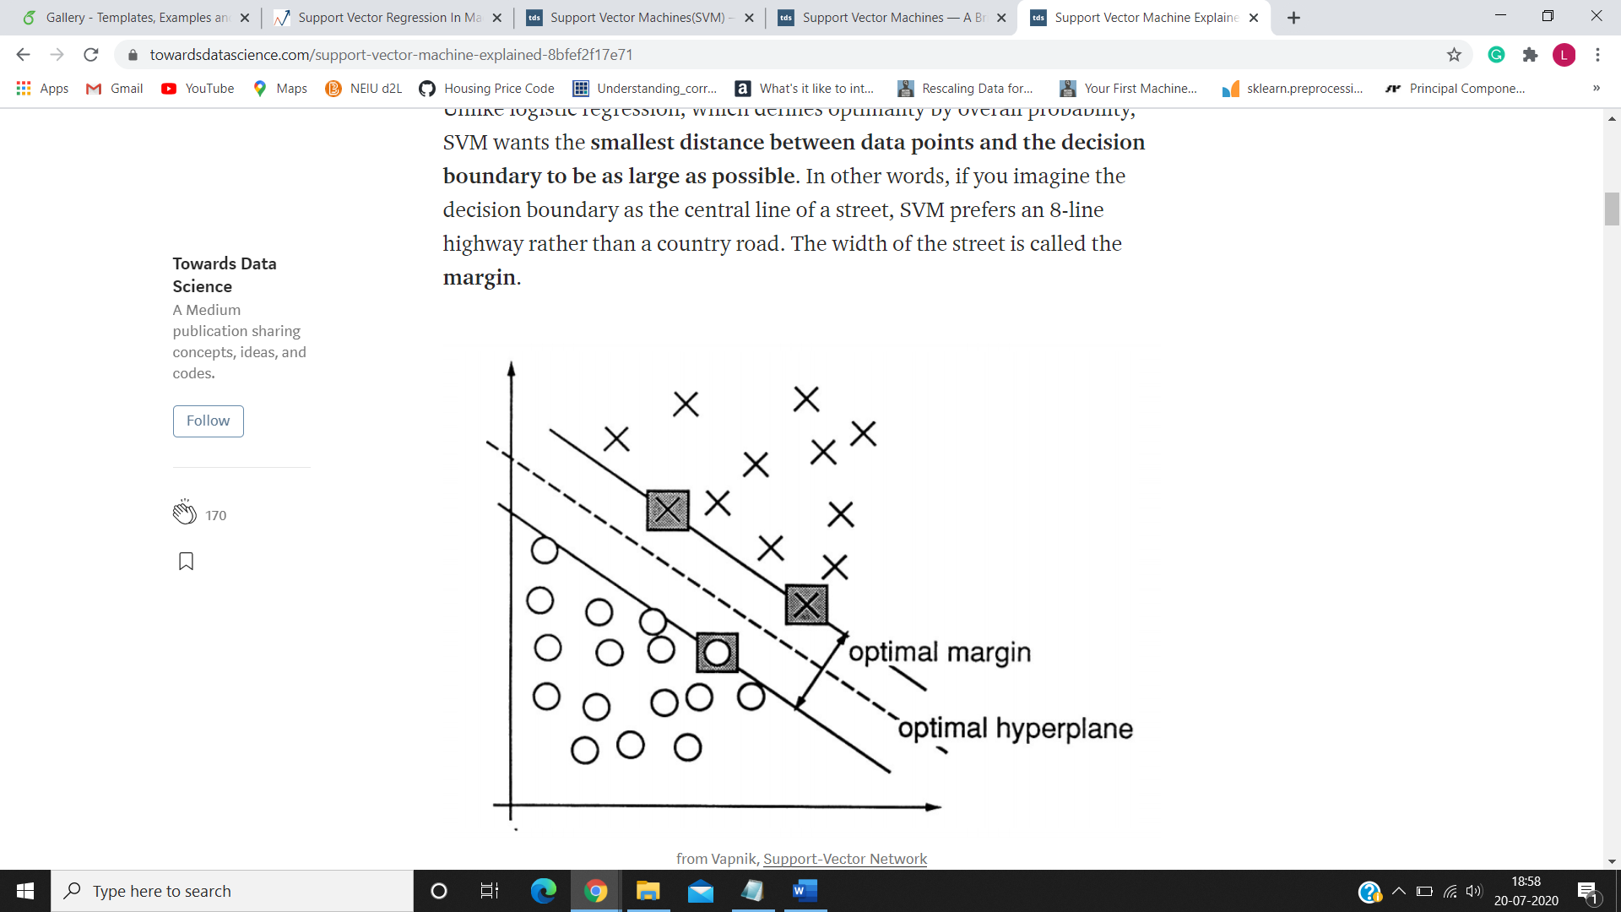
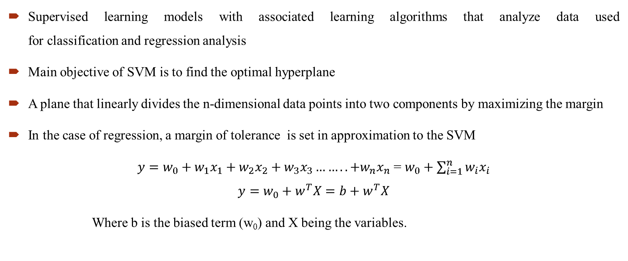
SVM Regression
Supervised learning models with associated learning algorithms that analyze data used for classification and regression analysis
Main objective of SVM is to find the optimal hyperplane
A plane that linearly divides the n-dimensional data points into two components by maximizing the margin
In the case of regression, a margin of tolerance is set in approximation to the SVM
$y=w_{0}+w_{1}x_{1}+w_{2}x_{2}+w_{3}x_{3}……..+w_{n}x_{n}$ = $w_{0}+\sum_{i=1}^{n}{w_{i}x_{i}}$
$$y=w_{0}+w^{T}X=b+w^{T}X$$
Where b is the biased term (w₀) and X being the variables.
Image Source :https://towardsdatascience.com/support-vector-machines-svm-c9ef22815589
Notes:
Support-vector machines (SVMs, also known as support-vector networks)
The main objective of SVM is to find the optimal hyperplane, a plane that linearly divides the n-dimensional data points into two components by maximizing the margin. In the case of regression, a margin of tolerance (epsilon) is set in approximation to the SVM

Slide 19
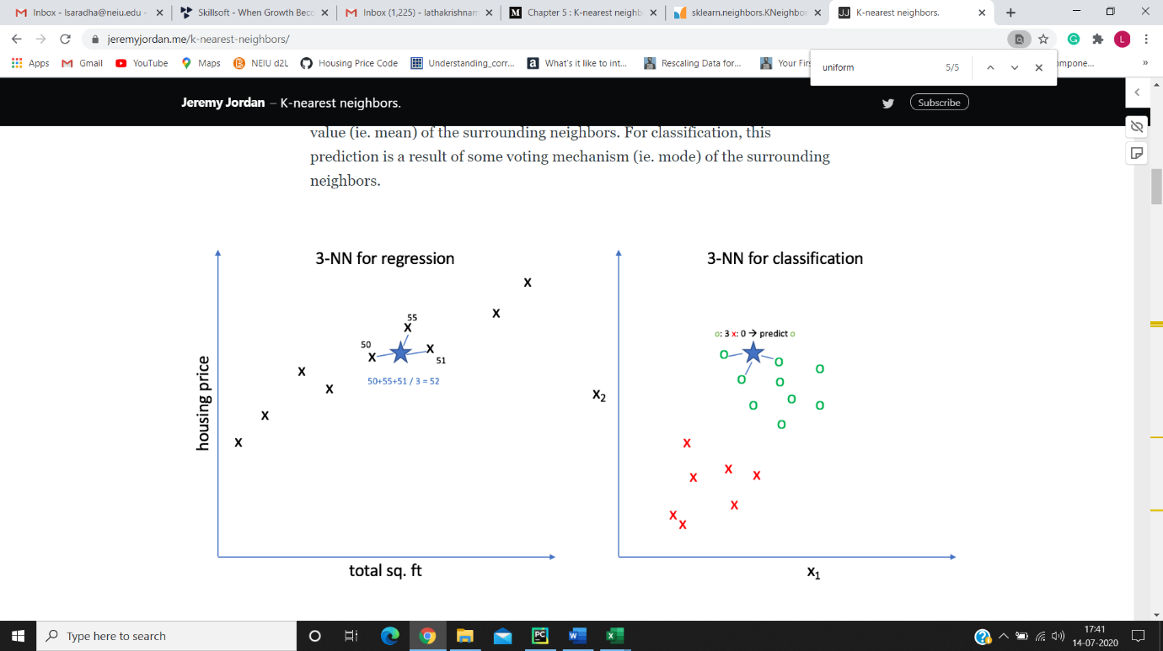
K- Nearest Neighbor
A simple algorithm that stores all available cases and classifies new cases based on a similarity measure
For new data point, calculates the distance from the new data point to all other points in the data-set
Depending on the K value, it identifies the nearest neighbor(‘s) in the data set
All points in each neighbourhood are weighted equally and the number of neighbors is set to 6.
Notes:
If K=1 then it takes the minimum distance of all points and classifies as the same class of the minimum distance data point.
If k>1 then it takes a list of K minimum distances of all data points. For regression, it takes the average of all values in the list.

Slide 20
Random forest regression
A Supervised Learning algorithm that uses the ensemble learning method.
A method where multiple learning algorithms combined to obtain predictive performance
Operated by constructing a multitude of decision trees at training time and outputting the mean prediction of the individual trees
Main feature is number of features split on at each node is limited to some percentage of the total
Ensures that the model does not rely on any individual feature, using all potentially predictive features
Each tree draws a random sample from the original data set when generating its splits
Adding an element of randomness that prevents overfitting
Notes:
a method where multiple learning algorithms combined to obtain predictive performance
Adding an element of randomness that prevents overfitting

Slide 21
XGBoost regression
XGBoost stands for eXtreme Gradient Boosting
The weak learners are regression trees, and each regression tree maps an input data point to one of its leaves that contains a continuous score.
Some key algorithm implementation features include:
Automatic handling of missing data values.
Parallelization of tree construction.
Continued Training to further boost an already fitted model on new data
Notes:
Bagging is a way to decrease the variance in the prediction.
by generating additional data for training from dataset using combinations with repetitions to produce multi-sets of the original data.
Boosting is an iterative technique which adjusts the weight of an observation based on the last classification.

Slide 22
Results
Linear regression accuracy increased as the features were added one by one -62.41%
SVM model had more accuracy than Linear Regression – 62.9%
In KNN model standardization has minimal effect
In Random Forest regression, R2 increases by 5% when for dataset without standardization
XGBoost results are similar to the Random Forest with a small deviation of value in accuracy and error
The Random Forest Model have the most accuracy and least error
Method | With Standardization | Without Standardization
KNN | 78.12 % | 78.11 %
Random Forest | 82.73 % | 87.67 %
XGBoost | 80.18 % | 82.91 %

Slide 24
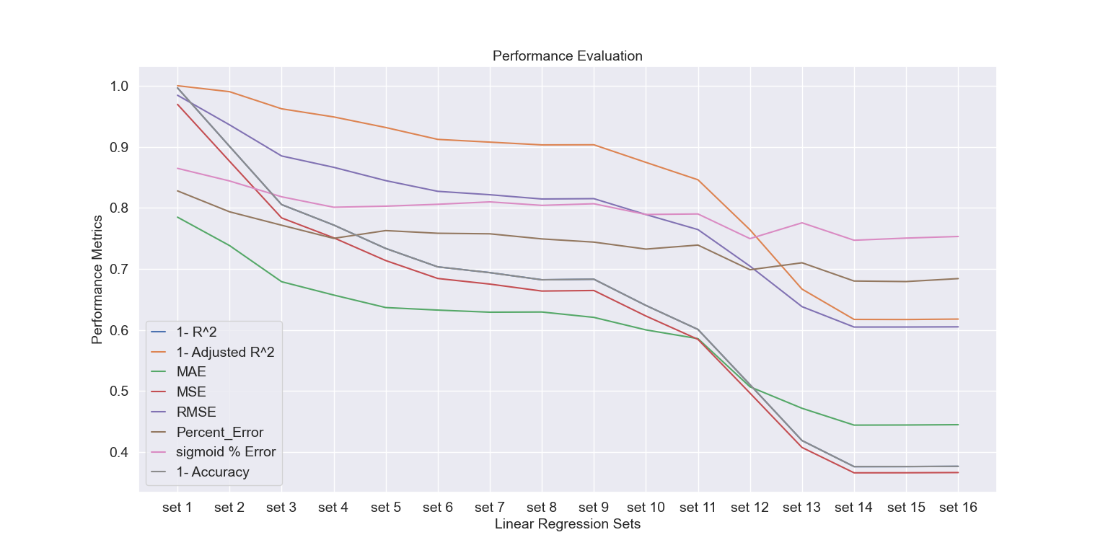
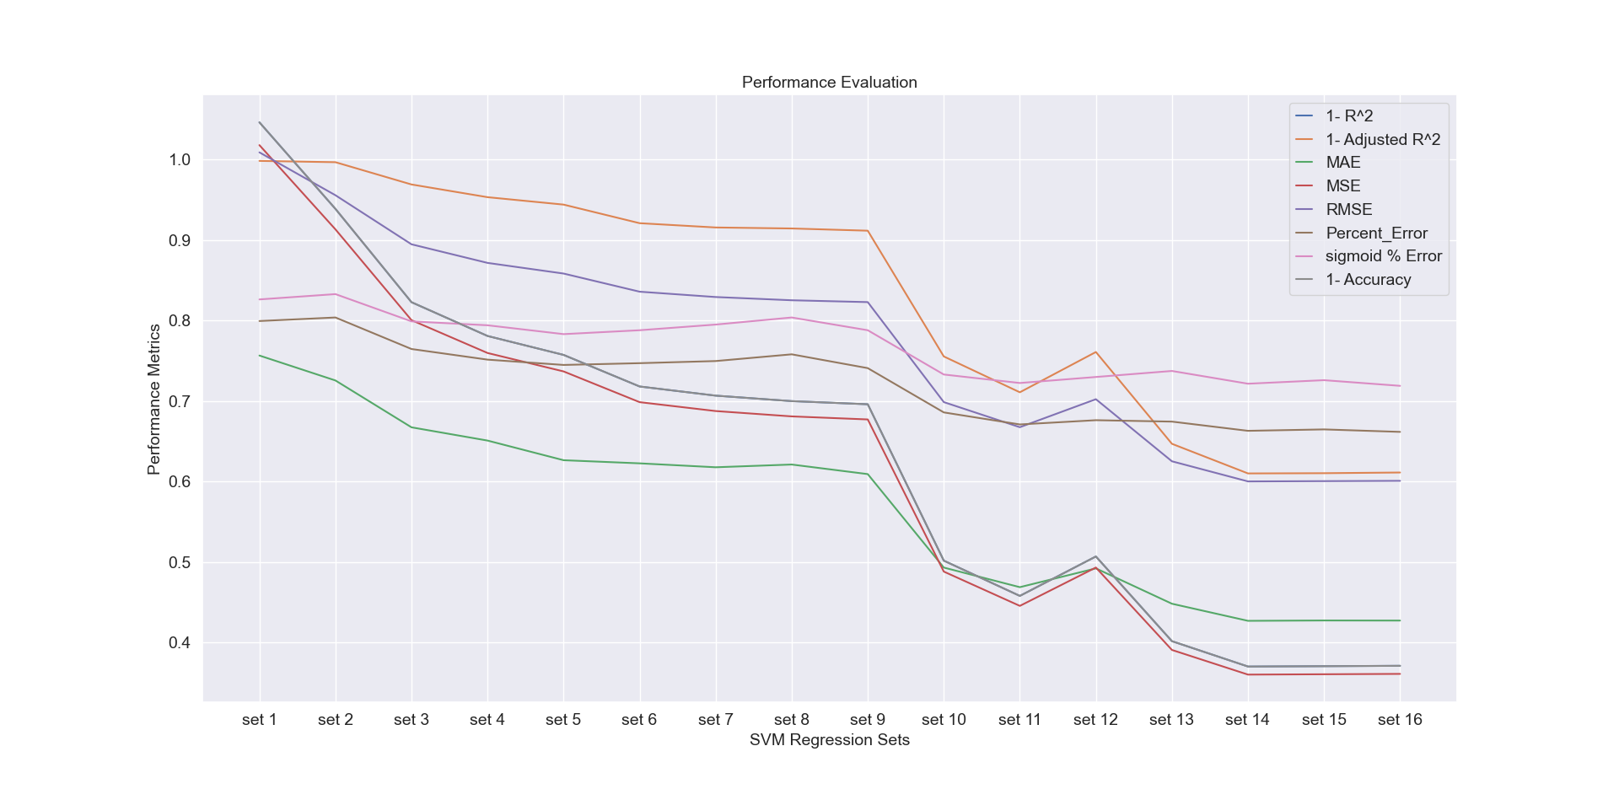
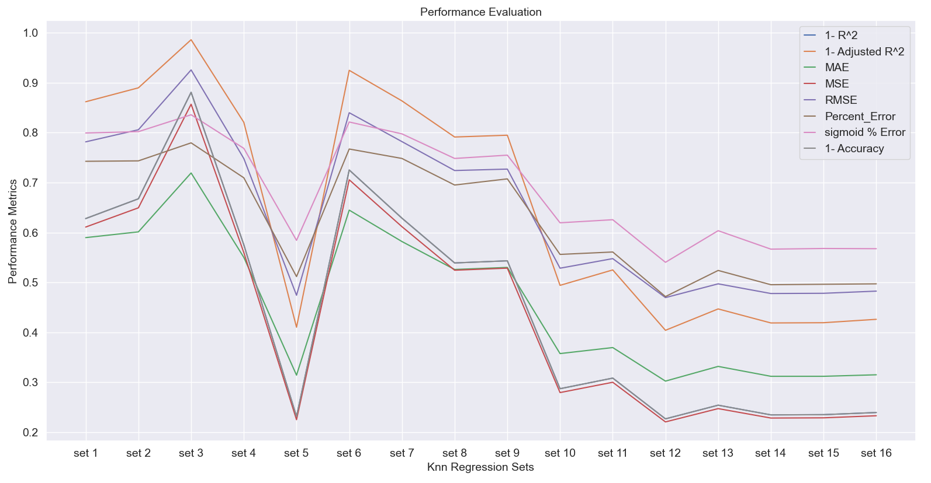
Notes:
This graph indicates how the model performs for different sets of feature combination

Slide 25
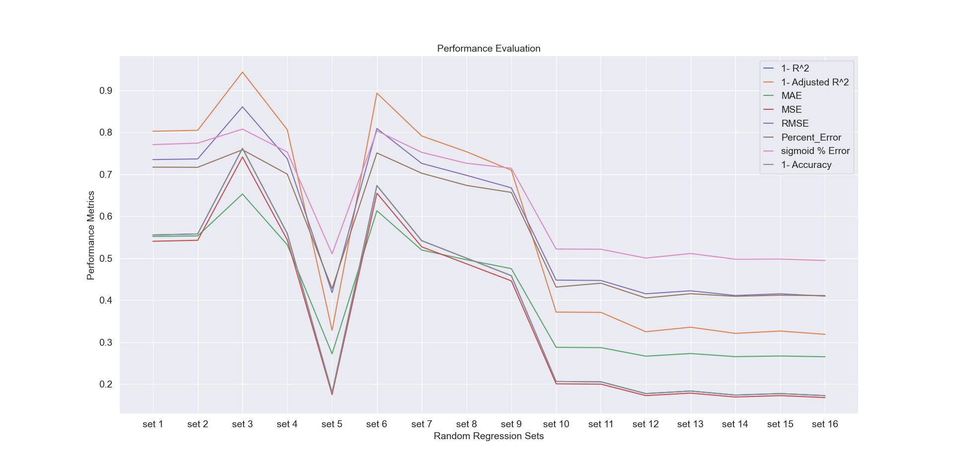
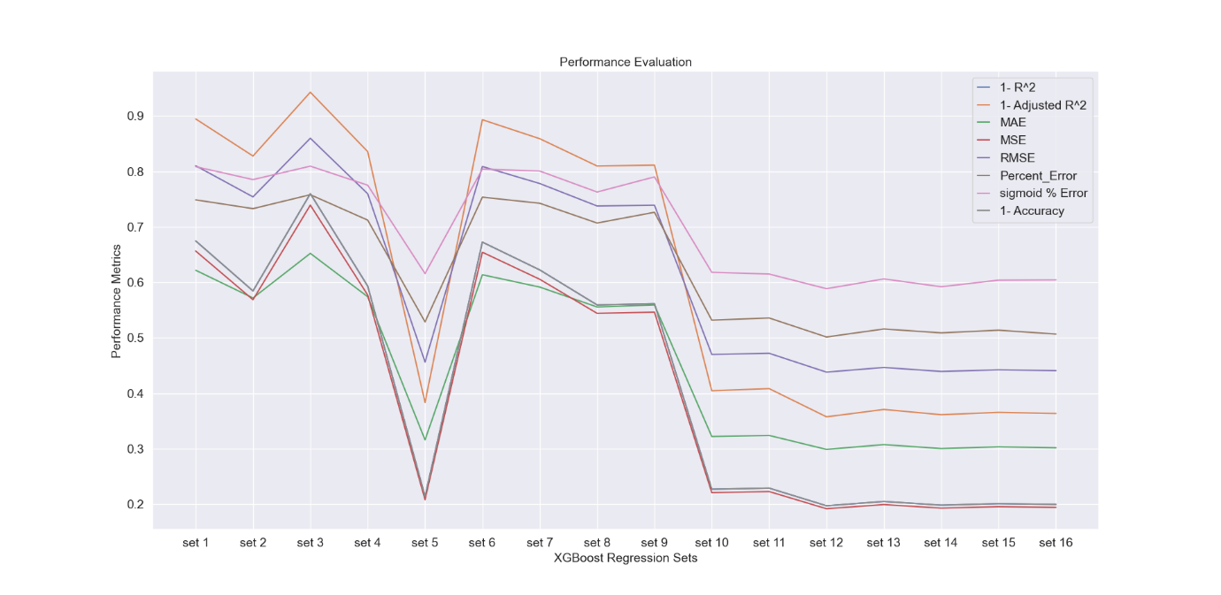

Slide 26
Set | Columns List
1 | ['Population']
2 | ['ZIP_OR_POSTAL_CODE']
3 | ['Total Numb of Hospitals']
4 | ['Total Numb. Of Complaints’, ‘Total crimes’, ‘Level A School Count']
5 | ['BATHS','SQUARE_FEET','YEAR_BUILT','LATITUDE','LONGITUDE','AGE','CITYnumeric']
6 | ['Total Numb of Subways']
7 | ['Total_Num_of_Subways','min_dist_station','Num_of_Retail_stores','min_dist_retail_store']
8 | ['Total_crimes','Level_A_SchoolCount','Level_B_SchoolCount','Level_C_SchoolCount','Level_D_SchoolCount','Level_F_SchoolCount','Total_Number_of_Schools','Num_Complaints_schools','Population','People/Sq. Mile’, 'Total Num of Hospitals']
9 | ['Level_F_SchoolCount','Total_Number_of_Schools','Num_Complaints_schools','Population','People/Sq_Mile','Total_Num_ofHospitals','Total_Num_of_Subways','min_dist_station','Num_of_Retail_stores','min_dist_retail_store']
10 | ['SQUARE_FEET','YEAR_BUILT','LATITUDE','LONGITUDE','AGE','CITYnumeric','Total_Num_ofComplaints','Total_crimes','Level_A_SchoolCount','Level_B_SchoolCount','Level_C_SchoolCount']
11 | ['SQUARE_FEET','YEAR_BUILT','LATITUDE','LONGITUDE','AGE','CITYnumeric','Total_Num_ofComplaints','Total_crimes','Level_A_SchoolCount','Level_B_SchoolCount','Level_C_SchoolCount','Level_D_SchoolCount','Level_F_SchoolCount','Total_Number_of_Schools','Num_Complaints_schools']
12 | ['ZIP_OR_POSTAL_CODE','BEDS','BATHS','SQUARE_FEET','YEAR_BUILT','LATITUDE','LONGITUDE','AGE','CITYnumeric','Total_Num_ofComplaints','Total_crimes','Level_A_SchoolCount']
13 | ['BATHS','SQUARE_FEET','YEAR_BUILT','LATITUDE','LONGITUDE','AGE','CITYnumeric','Total_Num_ofComplaints','Total_crimes','Level_A_SchoolCount','Level_B_SchoolCount','Level_C_SchoolCount','Level_D_SchoolCount','Level_F_SchoolCount','Total_Number_of_Schools','Num_Complaints_schools','Population']
14 | ['ZIP_OR_POSTAL_CODE','BEDS','BATHS','SQUARE_FEET','YEAR_BUILT','LATITUDE','LONGITUDE','AGE','CITYnumeric','Total_Num_ofComplaints','Total_crimes','Level_A_SchoolCount','Level_B_SchoolCount','Level_C_SchoolCount','Level_D_SchoolCount','Level_F_SchoolCount','Total_Number_of_Schools','Num_Complaints_schools','Population','People/Sq_Mile','Total_Num_ofHospitals','Total_Num_of_Subways','min_dist_station','Num_of_Retail_stores','min_dist_retail_store']
15 | ['BEDS','BATHS','SQUARE_FEET','YEAR_BUILT','LATITUDE','LONGITUDE','AGE','CITYnumeric','Total_Num_ofComplaints','Total_crimes','Level_A_SchoolCount','Level_B_SchoolCount', 'Level_C_SchoolCount','Level_D_SchoolCount','Level_F_SchoolCount','Total_Number_of_Schools','Num_Complaints_schools','Population','People/Sq. Mile', ’, 'Total Num of Hospitals’,'Total_Num_of_Subways','min_dist_station','Num_of_Retail_stores','min_dist_retail_store']
16 | ['BEDS','BATHS','SQUARE_FEET','YEAR_BUILT','LATITUDE','LONGITUDE','AGE','CITYnumeric','Total_Num_ofComplaints','Total_crimes','Level_A_SchoolCount','Level_B_SchoolCount', 'Level_C_SchoolCount','Level_D_SchoolCount','Level_F_SchoolCount','Total_Number_of_Schools','Num_Complaints_schools','Population','People/Sq. Mile', ’, 'Total Num of Hospitals’, 'Total_Num_of_Subways','min_dist_station','Num_of_Retail_stores','min_dist_retail_store','Num_of_Retail_stores_Zipcode']
Notes:
This table showcases the combination of features in each set.

Slide 27
Future Work
Principal component analysis (PCA) to be performed to reduce the number of features
The model performance can be measured with and without applying PCA
Apply filter conditions as per the user’s area and locality
Implement different neural network models to improve the performance of the model
Finding the outliers in the combined dataset and evaluate the performance after outlier removal

Slide 28
References
2009-2010 School Progress Reports - All Schools. (n.d.). Retrieved from NYC Open Data: https://data.cityofnewyork.us/Education/2009-2010-School-Progress-Reports-All-Schools/ffnc-f3aa
2010-2016-School-Safety-Report . (n.d.). Retrieved from City of New York: https://data.cityofnewyork.us/Education/2010-2016-School-Safety-Report/qybk-bjjc/data
K Nearest Neighbours. (n.d.). Retrieved from www.saedsayad.com/ https://www.saedsayad.com/k_nearest_neighbors.htm
New York Population Density Zip Code Rank. (n.d.). Retrieved from USA.com: http://zipatlas.com/us/ny/zip-code-comparison/population-density.htm
NYC Health + Hospitals patient care locations - 2011. (n.d.). Retrieved from NYC Open Data: https://data.cityofnewyork.us/Health/NYC-Health-Hospitals-patient-care-locations-2011/f7b6-v6v3
NYC Subways Stations. (n.d.). Retrieved from mta.info: http://web.mta.info/developers/data/nyct/subway/Stations.csv
NYPD-Complaint-Data-Current-Year-To-Date. (n.d.). Retrieved from NYC Open Data: https://data.cityofnewyork.us/Public-Safety/NYPD-Complaint-Data-Current-Year-To-Date-/5uac-w243

Slide 29
Project advisors
Primary Advisor : Dr. Manar Mohaisen
Secondary Advisor : Dr. Rachel Trana
I thank my advisors for supporting and guiding me through out my Master’s Project.

Slide 30
Questions ???

